Slide 1



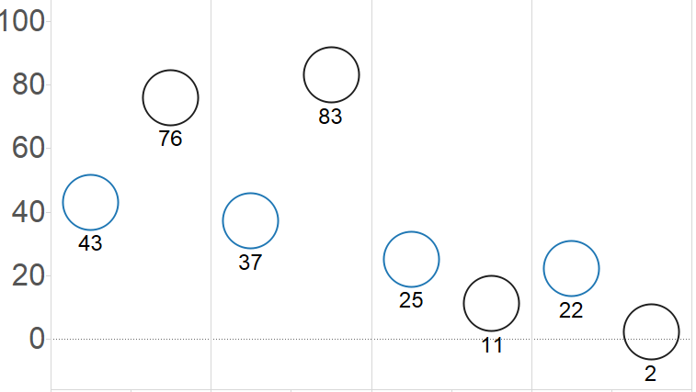

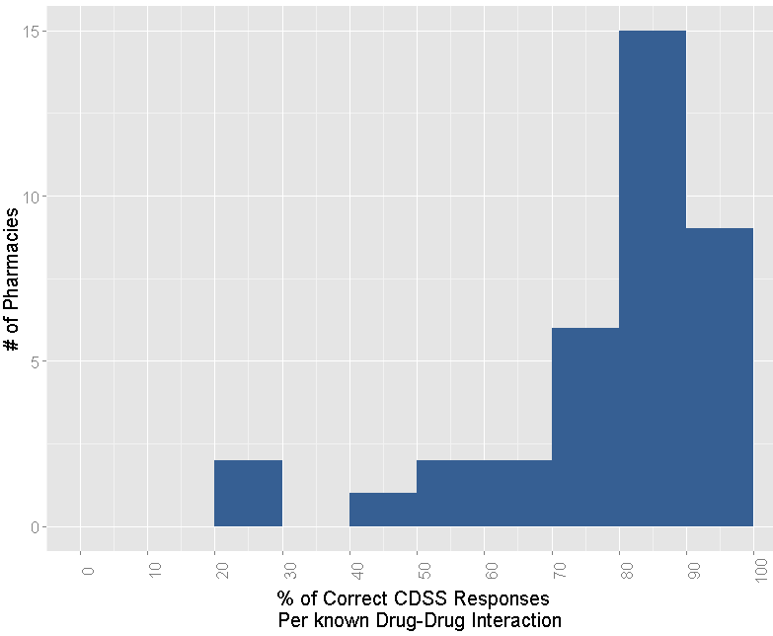
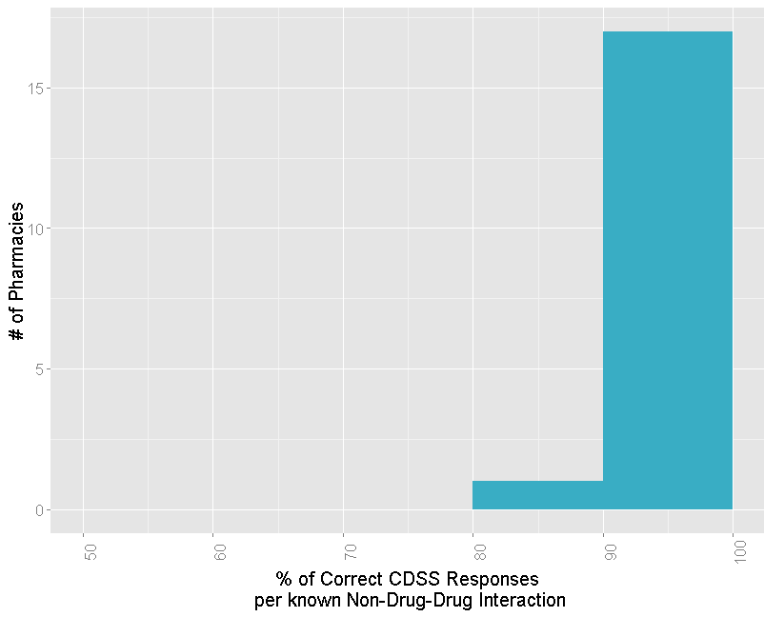

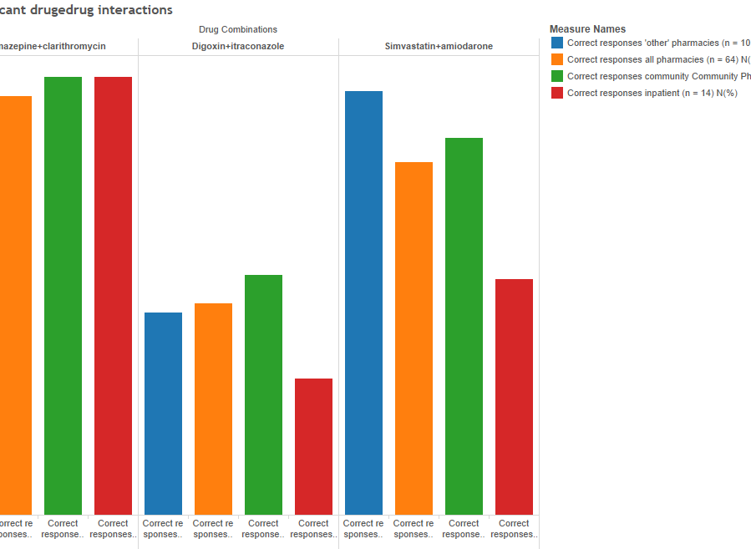


Assessing the Performance and Usability of Clinical Decision Support Systems in the Pharmacy
Johnathan Yuen and Willie Man
The University of Texas at Austin, Health Informatics and Health IT Certificate Program , Spring 2016
ABSTRACT
RESULTS
DISCUSSION AND CONCLUSIONS
Clinical decision support systems (CDSS) have been increasingly
implemented within pharmacies nationwide because of its ability
to assist in improving prescribing practices. Thus, we conducted a
literature review to assess the CDSS performance in various
pharmacy settings. We found that the utilization of CDSS in
pharmacies contributed many beneficial impacts, which include:
improving accurate antibiotic dosages, increasing the number of
interventions and cost savings, and accurate detection of drug
drug interactions (DDI) and non-interactions.
Figure 1: Effects of CDSS on Administering Recommended Amikacin and Tobramycin Dosage Intervals Relative to a Standardized Reference Value (n)^{[1]}
Figure 2: Changes in Average Number of Interventions Monthly (a) and Cost Savings Annually (b) Following CDSS Implementation^{[5]}
Summary of Findings:
In this literature review, the overall consensus was that CDSS have a positive impact in the pharmacy. Their benefits include:
Prescribing Support: Use of CDSS was statistically proven to increase accuracy in prescribing antibiotic drug dosages relative to a standard ^{[1]}.
Increased Number of Interventions and Cost Savings: Implementation of CDSS in a clinical pharmacy was shown to double the number of interventions and cost savings ^{[5]}.
Accurate Detection: CDSS were proven to accurately detect significant drug-drug interactions and non-interactions^{[4]}.
Author’s Perspective:
The limitations of CDSS include variation amongst CDSS software, alert fatigue, and competence of the pharmacist to act according to the produced alerts^{[2,4]}. These have been enumerated in detailed by the authors Saverno and Heringa and their respective colleagues. Despite these limitations, the abundance of evidence proves that CDSS can be used effectively in the pharmacy to positively impact the quality of healthcare and to improve patient safety.
Amakacin (P =.002)
Tobramycin (P < .001)
Amakacin (P = .0073)
Tobramycin (P = .0009)
a)
INTRODUCTION
% of Detected Dosage Intervals relative to n
In the continuum of healthcare, the pharmacy has proven to
be an integral component in providing healthcare to patients. However, like any other healthcare provider, pharmacies and
pharmacists make human errors that may have severe and harmful consequences on the patient’s well-being. These errors are called adverse drug effects (ADE), and they can consist of drug interactions, allergies, mis-prescribing a drug or its dosage, etc^{[4]}. While some forms of ADEs are unavoidable, the inability of pharmacists to detect these occurrences puts patients at serious risk ^{[2]}.
In today’s growing field of health information technology, clinical decision support system (CDSS) are modern innovations designed to provide clinical and decision support to healthcare providers. Within these systems, a database can be constructed and filled with information that can range from a patient’s medication history or allergies to general and specific knowledge of any known drug. Through cross-referencing, CDSS can provide pharmacists with valuable information to guide in the choice of proper treatment and can provide alerts to detect potential ADEs in time to intervene. Thus, the application of CDSS in the pharmacy has tremendous potential to improve the quality of health care and to increase patient safety.
b)
Doses Within 10% of n
Doses Within 10% of n
Doses Outside 25% of n
Doses Outside 25% of n
Cox and colleagues at Vanderbilt University Medical Center conducted a study to assess the effects of CDSS on the administration of two antibiotics – amakacin and tobramycin. The two experimental groups were administered amakacin and tobramycin individually at a dosage (units of mcg/ml) determined by the integrated CDSS. The results showed statistically significant improvements in prescribing correct dosages within a desired 10% interval and a decrease of detection in dosages outside a 25% interval.
Calloway and colleagues implemented a CDSS in the pharmacy department of Good Shepherd Medical Center in East Texas. They assessed the changes in number of interventions and costs savings following the implementation. The results portray approximately a two-fold increase in both the average number of interventions monthly and the annual cost savings.
REFERENCES
1. Cox ZL, Nelsen CL, Waitman LR, McCoy JA, Peterson JF. Clinical Decision Support Improves Initial Dosing and Monitoring of Tobramycin and Amikacin. American journal of health-system pharmacy : AJHP : official journal of the American Society of Health-System Pharmacists. 2011;68(7):624-632. doi:10.2146/ajhp100155.
2. Heringa, M., Floor-Schreudering, A., Tromp, P., Bouvy, P. Nature and frequency of drug therapy alerts generated by clinical decision support in community pharmacy. Pharmacoepidemiology and Drug Safety. NOV 2015, 25 (1) 82 - 89 DOI: 10.1002/pds.3915
3. Robertson, J., Walkom, E., Pearson, S., Hains, I., Williamsone, M., Newby, D. The impact of pharmacy computerised clinical decision support on prescribing, clinical and patient outcomes: a systematic review of the literature. Int J Pharm Pract. T2010 April; 18(2): 69–87
4. Saverno, K., Hines, L., Warholak, T., Grizzle, A., Babits, L., Clark, C., Taylor, A., Malone, D. (2011). Ability of pharmacy clinical decision-support software to alert users about clinically important drug—drug interactions. Journal of the American Medical Informatics Association Jan 2011, 18 (1) 32-37;DOI: 10.1136/jamia.2010.007609
5. Calloway S, Akilo HA, Bierman K. Impact of a Clinical Decision Support System on Pharmacy Clinical Interventions, Documentation Efforts, and Costs. Hospital Pharmacy. 2013;48(9):744-752. doi:10.1310/hpj4809-744.2
Figure 3: Frequencies of Detection Accuracy for Each Drug Interaction (a) and Non-interaction (b)^{[4]}
Table 1: Performance of Drug-Interaction Recognition by Pharmacy Type^{[4]}
a)
b)
 | Sensitivity | Specificity | Positive Predictive Value (PPV) | Negative Predictive Value (NPV)
Community Pharmacy (N=40)
Median | 0.92 | 1.00 | 1.00 | 0.86
Maximum | 1.00 | 1.00 | 1.00 | 1.00
Minimum | 0.31 | 0.83 | 0.88 | 0.40
Inpatient Hospital Pharmacy (N=14)
Median | 0.77 | 1.00 | 1.00 | 0.67
Maximum | 1.00 | 1.00 | 1.00 | 1.00
Minimum | 0.38 | 0.83 | 0.93 | 0.43
“Other” Pharmacy (N=10)
Median | 0.85 | 1.00 | 1.00 | 0.75
Maximum | 1.00 | 1.00 | 1.00 | 1.00
Minimum | 0.23 | 1.00 | 1.00 | 0.38
PURPOSE
The purpose of this study is to assess the performance and usability of the CDSS in pharmacies.
ACKNOWLEDGMENTS
METHODS
We sincerely express our thanks to Dr. Leanne Field, for her mentorship and guidance on this project. We would also like to extend thanks to Dr. Richard Nauert, Mr. Robert Ligon, Ms. Rae Macha, Dr. Zechariah Varghese, and Mr. Michael Field for their various roles of support throughout the program.
This project was completed with guidance from Dr. Leanne Field. Queries of Google Scholar, PubMed, and the University of Texas Libraries were performed to locate articles for this poster. The keywords used include: clinical decision support system, adverse drug effects, efficiency, and pharmacy. Articles that were selected were found from the following journals: the Journal of American Medical Informatics Association, the Journal of Pharmacoepidemiology and Drug Safety, the Pharm Pract Journal, limiting the year of publication between 2009 and 2016. The selected articles were then studied to conduct this meta-analysis.
Saverno and co-investigators studied the ability of CDSS systems in 64 participating pharmacies to accurately detect known drug-drug interaction (DDI) (a) and known drug non-interactions (non DDI) (b). The drug-drug combinations were “chosen by consensus among the researchers based on their widespread use, clinical importance, … and level of documentation.” As shown in this histogram, the median of correct DDI and non DDI responses was 89% and 100%, respectively.
A binary classification test was conducted for each pharmacy to calculate each CDSS’s ability to recognize drug interactions that were clinically significant and to disregard those that were clinically insignificant; these measures are referred to as sensitivity and specificity respectively. The PPV, the probability that a drug alert is a true alert, and the NPV, the probability that an absence of an alert is a true absence, were also calculated. The authors found no statistical differences between pharmacy types using these four parameters.
CONTACT INFORMATION
Johnathan Yuen Johnathan.yuen@utexas.edu
Willie Man man.willie@utexas.edu

